Slide 1
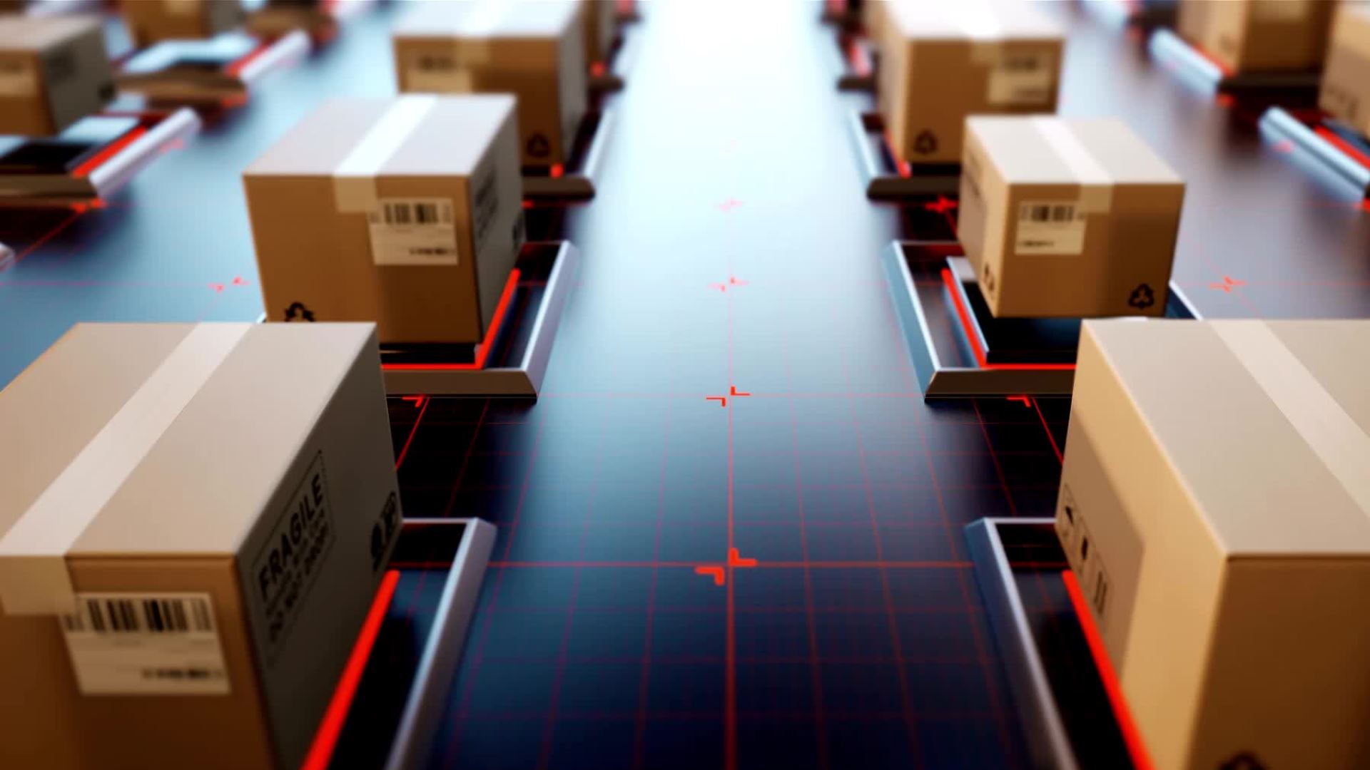
Technology Project: Toy E-Commerce
Group 2 (Ruth, Precious, Rian, Delia, Evelyn)

Slide 2



Tech Stack
Git/GitHub
VS Code
Python3
CSV, Pandas, Random, Faker

Slide 3
Payment failures & transactionIDs
Created a list for payment failures, consisting of 8 different options. These options are randomly chosen.
Created a list with 2 options, Y and N. These denote whether the payment was successful or a failure.
Created a random list with a range of 100 to 99,999.

Slide 4
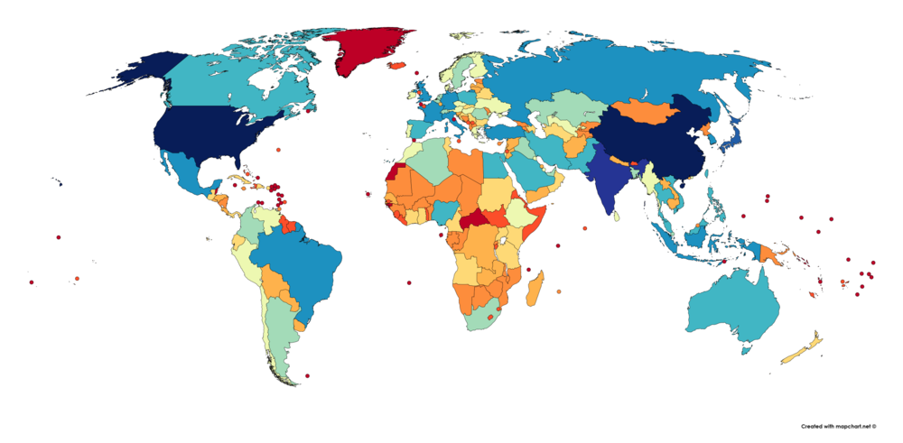
Locations Around the World
Created a generator to randomly place customers in a variety of cities and countries around the world.

Slide 5
Websites
Created a csv with websites corresponding to different countries to be randomly chosen based off location
CSV file consists of 15 websites for each country (15 countries) to be randomly chosen using the random module

Slide 6
Product ID, Product Name, Product Category and Price
Using a for loop and control flow statements, saved a random index to access a nested list of product categories containing product ID, name, and price.

Slide 7
What's Left...
Rogue Records
Data Visualization
Data Analysis

